Slide 1
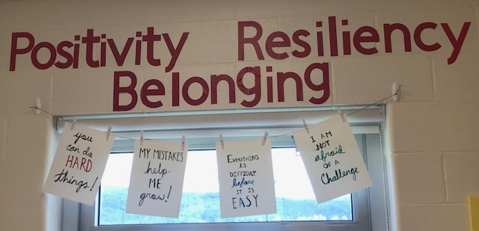
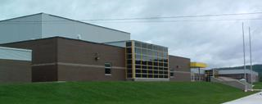
Welcome to PAMS 2020-21

Slide 2
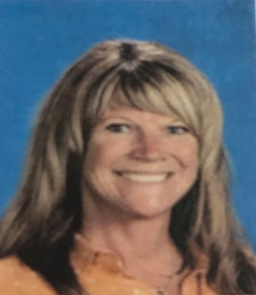
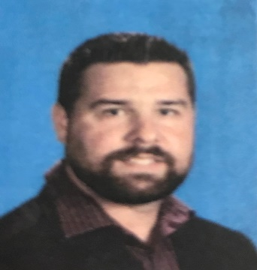
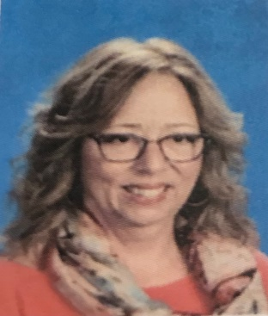
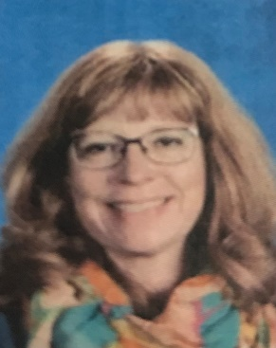
Meet the leadership team
Student Services
Mme. Dionne – Principal
Mr. Tompkins – Vice-Principal
Mrs. Baker – Guidance counsellor
Mrs. Merrithew – Resource teacher

Slide 3
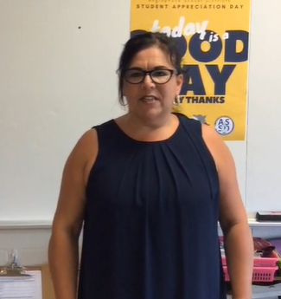
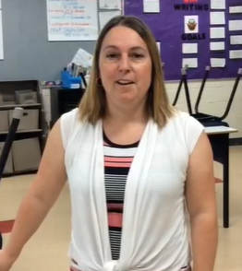
Meet the Team
Grade 6- ADVISORY
Ms. Cheeseman
Mme Michaud
TBA

Slide 4
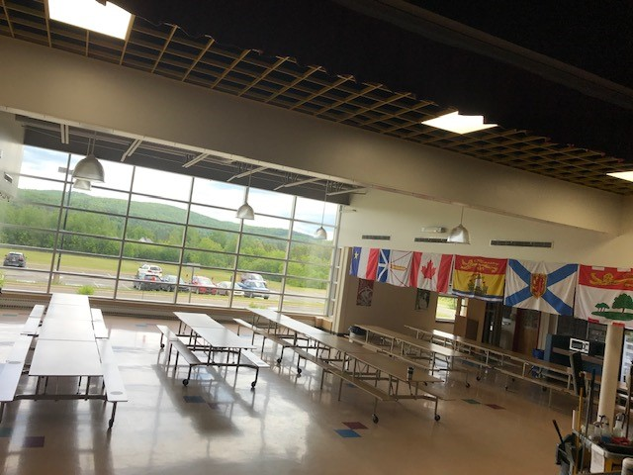
Other members of our staff
Educational Assistants (8)
Maliseet language teacher
Admin. Assistant
Custodians
Cafeteria

Slide 5
How is middle school different?
Different Classes (Technology and PDCP for example)
New Teachers & New Students
Lockers
Lunch Time Activities
Some New Expectations
Change your clothes for PE

Slide 6
Sometimes you’ll feel like you’re on a rollercoaster ride. Not to worry. That’s how any big change can make you feel.
Many Changes
Many Feelings
Making New Friends
Peer Pressure
Changes

Slide 7
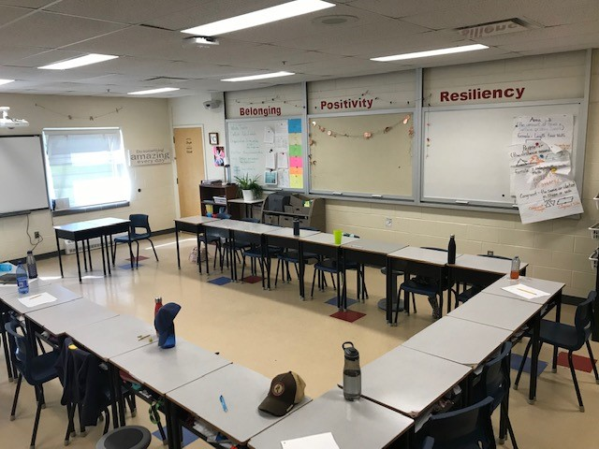
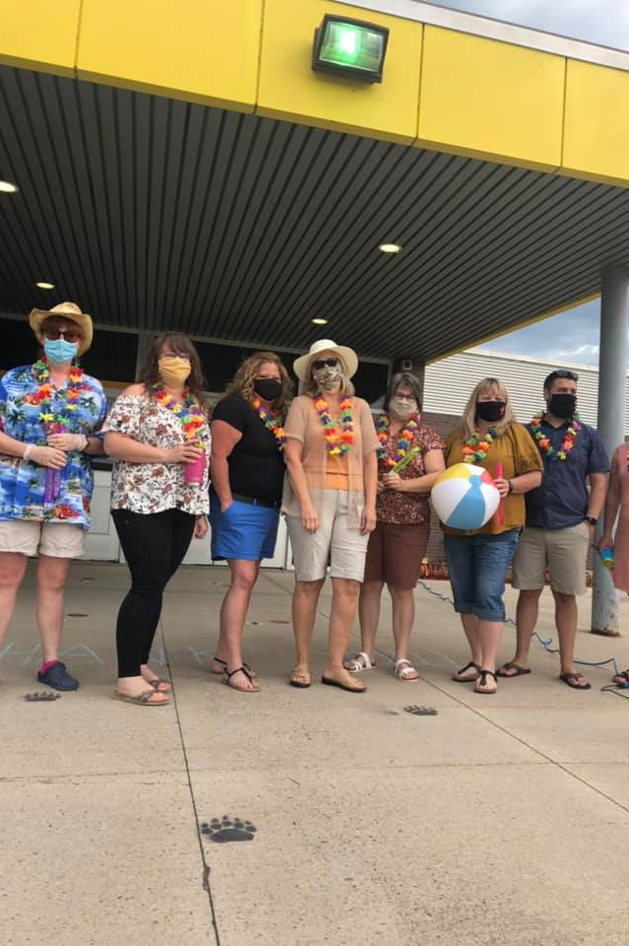
In 2021-22, PAMS will have
10 homerooms
203 students
30 staff

Slide 8
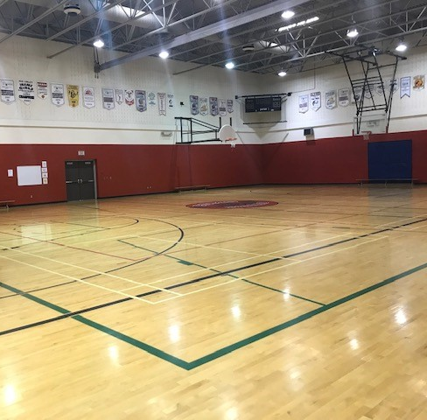
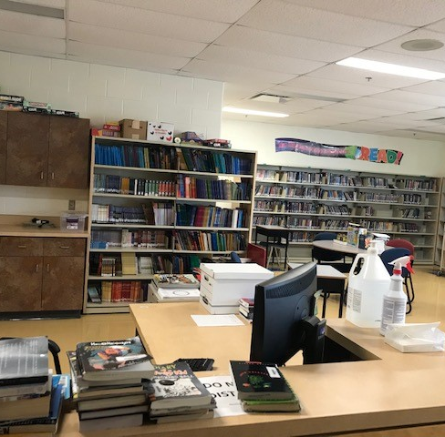
Classes
English Language Arts
Math
Science and Social Studies
Post Intensive French / French immersion
Maliseet language
Physical Education

Slide 9
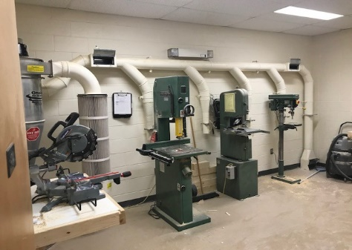
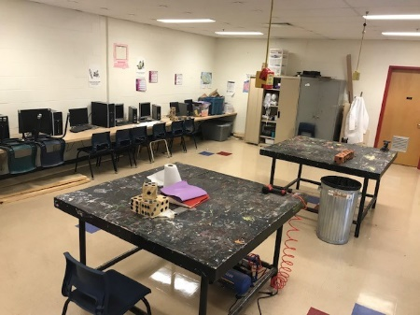
Exploratory classes- 12 week cycle -Health -Technology -Social Emotional Learning

Slide 10
Drop everything and READ - Students and staff read for PLEASURE every day.

Slide 11
Fees at PAMS for 2021-22 School supply pack - $30 Due the first day of school. If you want to buy supplies, there will be a list on our website. PAMS student fee- $30 Due October 31st. It covers the cost of: -Presentations -PAMS T-shirt - Art/ music/ technology supplies - School wide activities

Slide 12
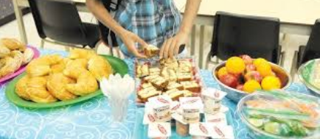
Cafeteria
Free breakfast program is available
Cafeteria is open at break and lunch

Slide 13
Electronic policy - Phones and electronics must be IN YOUR Locker - Permitted at break/ noon hour

Slide 14
Homework / Social Media
Check the web sitePAMS
Visit Instagram PAMS
Twitter /PAMS
You can also search for us on Facebook
Listen to voice mail

Slide 15
Awesome things about being at PAMS!
Principal’s List
Student Involvement Banquet
Lots of Sports Teams and Clubs
PHL
Dances
Theme Days

Slide 16
Let’s work together to make PAMS a fun and safe place to learn!
Keep and eye on our social media pages for meet the teacher dates!
We look forward to meeting your child on the first day of school September 7, 2021, and formally welcoming them to our Bears family!

